Slide 1
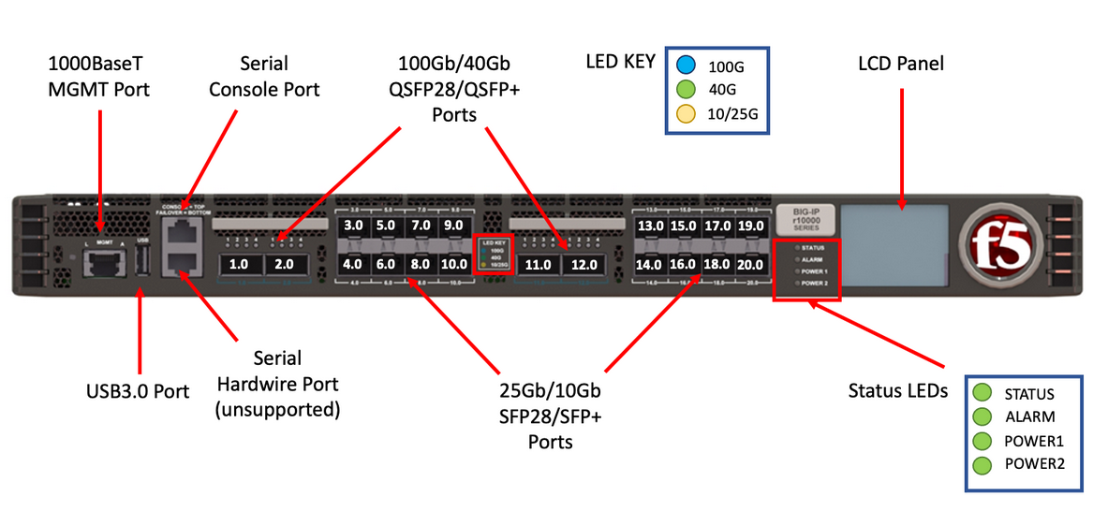
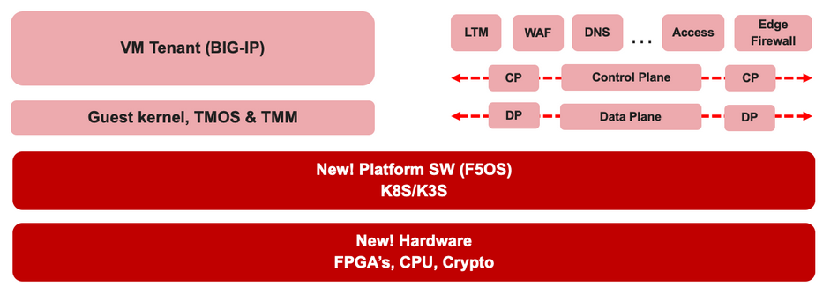

F5 rSeries Learning with
Alexander S

Slide 2
Agenda →
  iSeries to rSeries
  F5OS Basic Setup
  F5OS Upgrade Procedure
  VLAN and LAG Configuration
    Configure VLANs
    Configure LAG (Link Aggregation Group)
    Assign VLANs to the LAG
  Tenant OS Deployment Preparation
  Tenant OS Deployment
  rSeries Tenant Basic Setup
  High Availability (HA) in rSeries Tenants
    Best Practices for rSeries Tenant HA
    rSeries Tenant HA Configuration

Slide 3
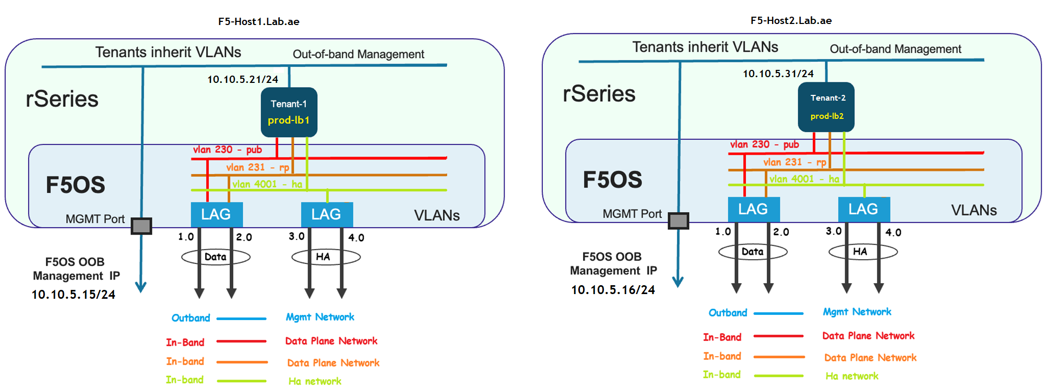
Chapter 7 – rSeries Tenant Basic Setup

Slide 4
Chapter 7 – rSeries Tenant Basic Setup
Task 01 - Change the Tenant Default Password
Task 02 - Activate the tenant license
Task 03 - Provision the required tenant modules
Task 04 - Renew the tenant certificate using the tenant hostname and IP address
Task 05 - Configure the tenant hostname, time zone, and root password
Task 06 - Set up DNS servers and domain names, and verify the name resolution
Task 07 - Configure NTP servers and verify the time synchronization
Task 08 - Verify LAG interfaces inherited from the host
Task 09 - Verify VLANs inherited from the host

Slide 5
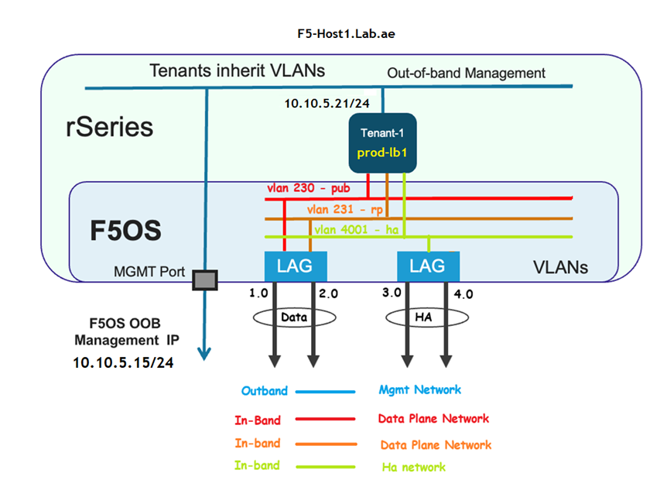
Chapter 7 – rSeries Tenant Basic Setup
Setting up the tenant1 in rSeries Host1

Slide 6
Chapter 7 – rSeries Tenant Basic Setup
Task 01 - Change the Tenant Default Password
Change the Tenant Default Password

Slide 7
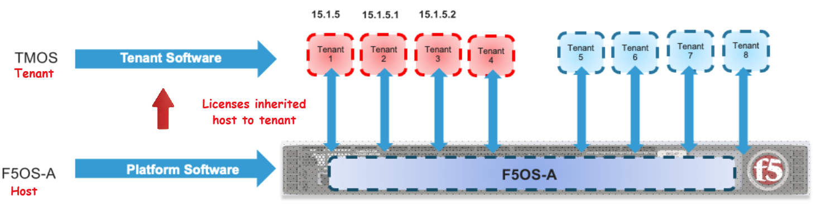
Chapter 7 – rSeries Tenant Basic Setup
Task 02 - Activate the tenant license

Slide 8
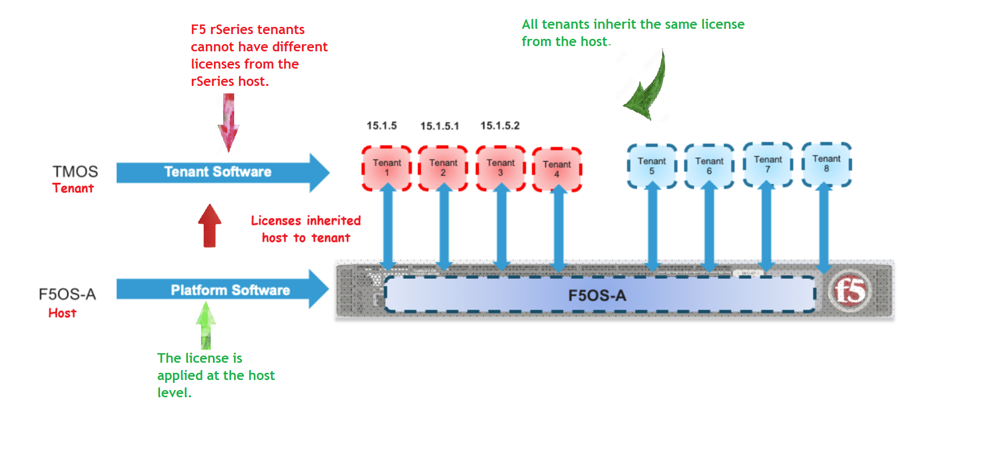
Chapter 7 – rSeries Tenant Basic Setup
Task 02 - Activate the tenant license

Slide 9
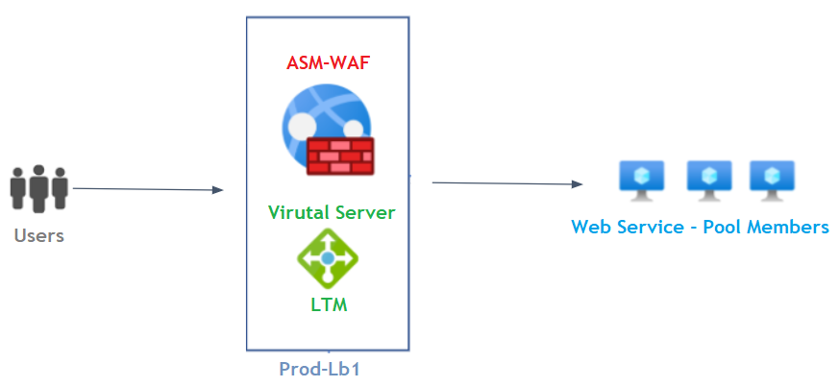
Chapter 7 – rSeries Tenant Basic Setup
Task 03 - Provision the Required Tenant Modules
Local Traffic Manager
  Deploy a Virtual Server for application publishing
  Virtual Server is a listener and is part of the Local Traffic Manager (LTM) module.
Application Security Manager
  Protect the virtual server using a Web Application Firewall (WAF) policy
  WAF is part of the Application Security Manager (ASM) module.

Slide 10


Chapter 7 – rSeries Tenant Basic Setup
Task 03 - Provision the Required Tenant Modules - Resource Provisioning Types
Nominal
Allocates the recommended amount of CPU and memory.
F5 recommends Nominal for most use cases because:
    It ensures stable performance under normal workloads.
    It avoids overuse of system resources.
Example:
Like ordering a medium pizza at Pizza Hut - just the right amount for a regular meal.

Slide 11

Chapter 7 – rSeries Tenant Basic Setup
Task 03 - Provision the Required Tenant Modules - Resource Provisioning Types
Minimum
Allocates the minimum (least) amount of CPU and memory required to run the tenant.
Suitable for testing or low-traffic environments.
Not recommended for production use due to limited resources.
Example:
Like ordering a small snack - enough to get by but not for a full meal.

Slide 12

Chapter 7 – rSeries Tenant Basic Setup
Task 03 - Provision the Required Tenant Modules - Resource Provisioning Types
Dedicated
Allocates maximum resources exclusively to the tenant.
Ideal for high-performance or production workloads.
Ensures no resource sharing with others.
Example:
Like having a large pizza just for yourself - no sharing, regardless of how much you eat.

Slide 13
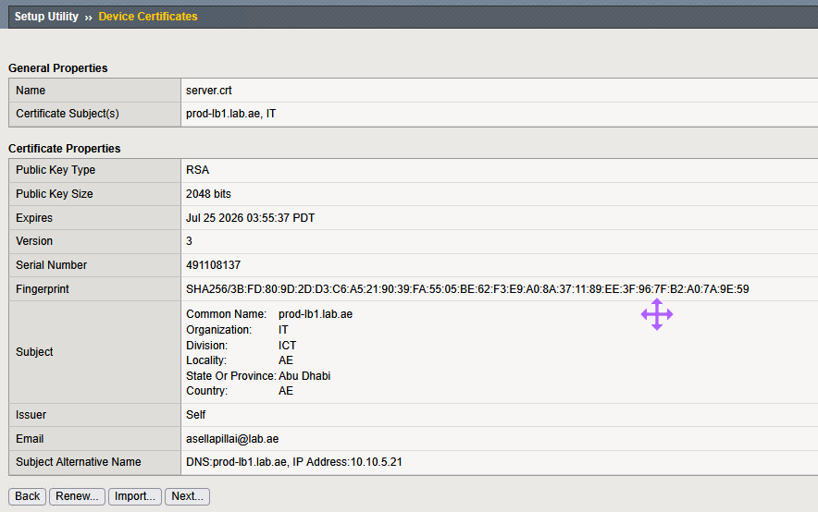
Chapter 7 – rSeries Tenant Basic Setup
Task 04 - Renew the tenant certificate using the tenant hostname and IP address
F5 provides a default self-signed certificate for the device using the default hostname.
The device certificate is important because modern browsers validate the IP address or hostname against the Subject Alternative Name (SAN) entries in the certificate.
Since we will be changing the device name, you should create a new device certificate using the Renew option.

Slide 14
Chapter 7 – rSeries Tenant Basic Setup
Task 05 - Configure the tenant hostname, time zone, and root password
Configure the Tenant Hostname : prod-lb1.lab.ae
Time zone : Asia/Dubai
Root Password

Slide 15
Chapter 7 – rSeries Tenant Basic Setup
Task 06 - Set up DNS servers and search domain, also verify the name resolution
Why do we need DNS in Tenant ???
It is important to configure DNS in the tenant, as it is required for:
  F5 License activation
  F5 Signature updates
  LDAP authentication
  Kerberos authentication

Slide 16
Chapter 7 – rSeries Tenant Basic Setup
Task 06 – DNS Search Domain
It is important to configure the DNS Search Domain, because it helps the system automatically append domain suffixes when resolving unqualified hostnames.
Alright - what is qualified and unqualified hostnames?
Qualified hostname is FQDN which is the name append with the correct domain name
for example - prod-lb1.lab.ae
Unqualified hostname is Short name which is just name without appending domain name
for example - prod-lb1
Let’s say you have the following search domains configured:
lab.ae
lab.local
If the system encounters the hostname as prod-lb1, it will automatically attempt to resolve:
prod-lb1.lab.ae
If that fails, then it will try prod-lb1.lab.local
The system checks each search domain in order until it finds a match or runs out of options.

Slide 17
Chapter 7 – rSeries Tenant Basic Setup
Task 06 – Scope is test the name resolution and search domain
Our scope is not limited to just configuring DNS and search domains.
  We need to test DNS name resolution.
  Also, We test the search domain is correctly added when the system encounters unqualified hostname.
  To do this, we need to log in to the tenant CLI.

Slide 18
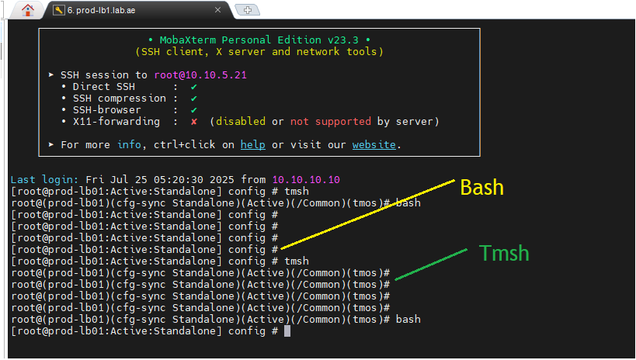
Chapter 7 – rSeries Tenant Basic Setup
Task 06 – Tenant CLI Bash and TMSH
TMOS Shell (Tmsh) will take the user directly to the TMSH shell.
Advanced Shell takes the user directly to the Linux shell (commonly referred to as bash).
If you are a device administrator, you can switch between tmsh and bash as needed.
Use bash from tmsh to enter bash, and type tmsh from bash to return to tmsh.

Slide 19
Chapter 7 – rSeries Tenant Basic Setup
Task 07 - Configure NTP servers and verify the time synchronization
Why do we need NTP in Tenant ???
✅ License validation: Many licenses are time-sensitive and require the device clock to be accurate for validation checks.
✅ Device High Availability (HA) synchronization: Accurate time is essential for event coordination, failover decisions, and state replication between HA peers.
✅ Authentication mechanisms (e.g., Kerberos): Protocols like Kerberos rely on timestamp-based tokens, and clock skew can cause authentication failures.
✅ Log validation and correlation: Time-synchronized logs ensure accurate forensic analysis, troubleshooting, and event correlation across systems.
Time mismatches can lead to failures in these critical functions, so configuring NTP is highly recommended.

Slide 20
Chapter 7 – rSeries Tenant Basic Setup
Task 08 - Verify LAG interfaces inherited from the host
Check that the HA and Data LAGs are inherited from the host to the tenant.
Important point to note here.
  F5 has renamed LAG to Trunk in the rSeries host, but tenants still display it as trunk.
  No worries - this is just a cosmetic difference.

Slide 21
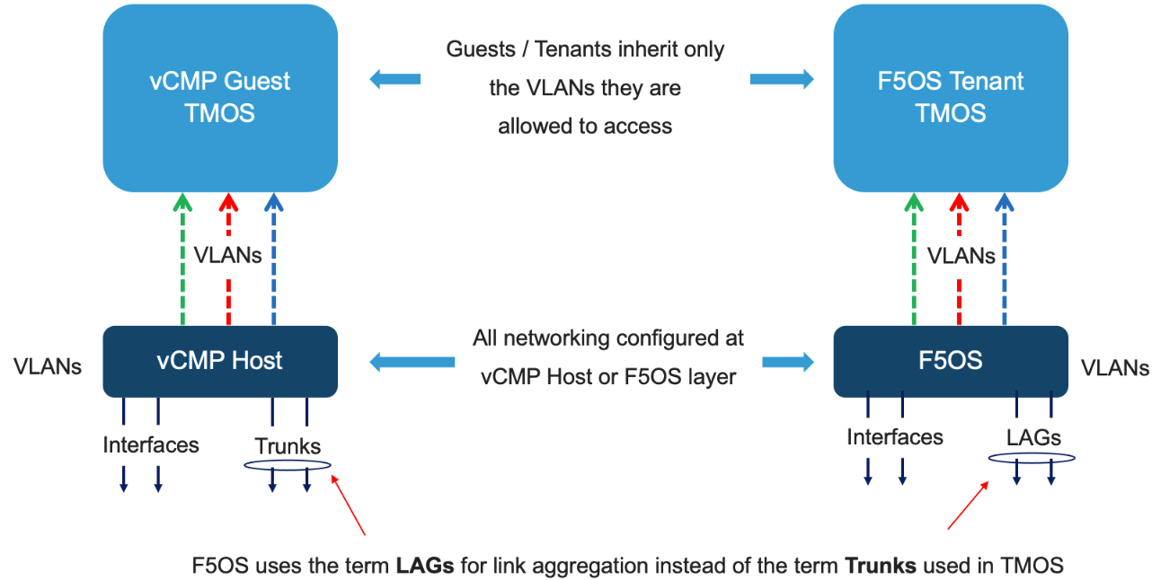
Chapter 7 – rSeries Tenant Basic Setup
Task 08 - Verify LAG interfaces inherited from the host
F5OS uses LAGs instead of the term trunks

Slide 22
Chapter 7 – rSeries Tenant Basic Setup
Task 09 - Verify VLANs inherited from the host
Verify DATA and HA vlans are inherited from the rSeries host to Tenant

Slide 23
Chapter 7 – rSeries Tenant Basic Setup
Setting up the tenant1 in rSeries Host1 - Done

Slide 24
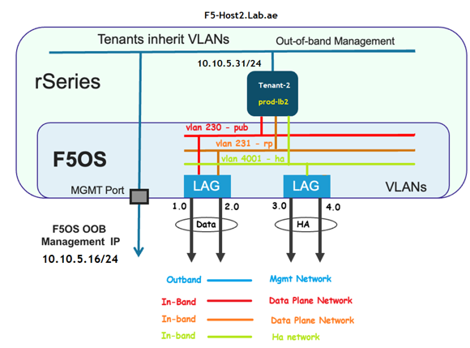
Chapter 7 – rSeries Tenant Basic Setup
Setting up the tenant2 in rSeries Host2

Slide 25
Chapter 7 – rSeries Tenant Basic Setup
Setting up the tenant2 in rSeries Host2 - Done

Slide 26
Now, both tenants, prod-lb1.lab.ae and prod-lb2.lab.ae have been successfully configured with the basic setup.

Slide 27
👉 Please watch my next video which is rSeries Tenant Networking and High Availability
In that video, we will:
  Configure the Data Network Self IP for client side and server side vlans
  Configure the HA Network Self IP for HA vlan
  Discuss rSeries High Availability
  Set up HA between Tenant1 and Tenant2 using HA vlan
  Configure routing and test the HA synchronization
Thank you for watching!

Slide 28
Please continue by watching the next video.
Next video is – Tenant OS Deployment – Thank you!!!

